Slide 1
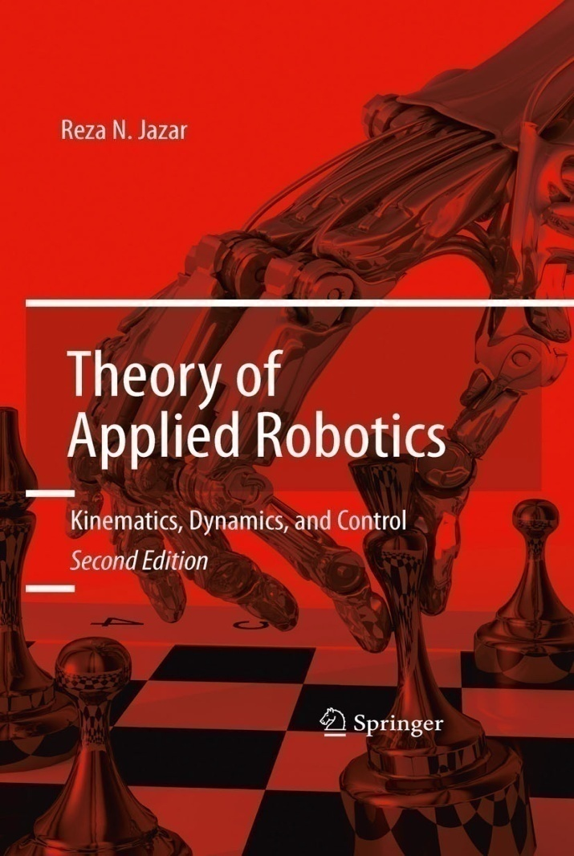
California State University, San Bernardino
School of Computer Science and Engineering
CSE 541 Robotics and Control
Chap. 2
Instructor: Haiyan Qiao

Slide 2
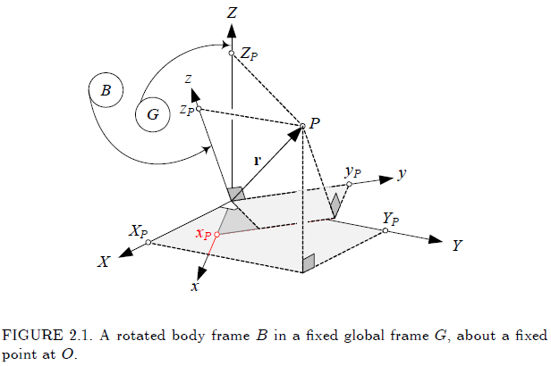
Chapter 1. Rotation Kinematics
We represent the rigid body by a body coordinate frame B, that rotates in another coordinate frame G.

Slide 3
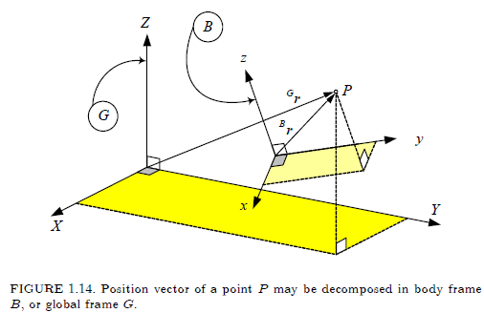
California State University, San Bernardino
School of Computer Science and Engineering

Slide 4


2.0. Matrix Calculation
1. The rule for multiplying is : go across the first matrix, and down the second matrix, multiplying the corresponding entries, and adding the products.
Scalar Multiplication

Slide 5



2. Transpose
Example

Slide 6



3. The Identity Matrix
Example
4. Determinants

Slide 7




5. Minors
Example
6. Minors and Cofactors

Slide 8





7. Determinant of a 3X3 Matrix
Example
2.4.(-2) + 1.3.(-5) + (-1).0.0 - 2.0.3 – 1.0(-2) – (-1).4.(-5) = -16 – 15 + 0 - 0 - 0 - 20 = -51
8. Inverse of a 2X2 Matrix

Slide 9






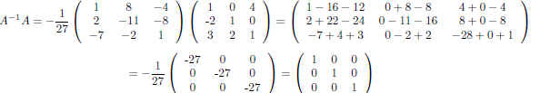
8.1 Determinant of a 3X3 Matrix

Slide 10






10 Linear Systems

Slide 11

10 Orthogonal Matrix
The inverse of an orthogonal matrix is simply the transpose of that
matrix
Example : a = cos , , b = -sin , c= sin , d = cos

Slide 12
11. Eigenvalues and Eigenvetors
Eigenvalue( ) : Any number such that a given matrix minus that number times the identity matrix has zero determinant
Eigenvector (x) : A nonzero vector that is mapped by a given linear transformation of a vector space onto a vector that is the product of a scalar multiplied by the original vector
Matrix (A) : The matrix that we use
Ax = x, (A - I)x = 0
A =
x1 = (1, 1), x2 = (-1, 1)
(A - I)x = x = 0

Slide 13

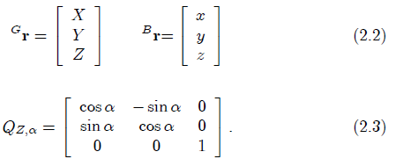
2.1. Rotation About Global Cartesian Axes
If the rigid body B rotates degree about the Z-axis of the global coordinate frame, then coordinates of any point P of the rigid body in the local and global coordinate frames are related by the following equation.

Slide 14
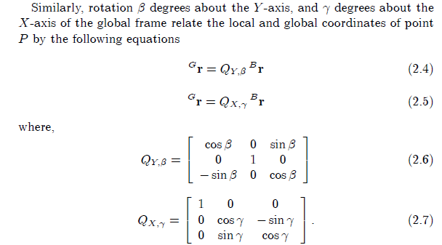

Slide 15
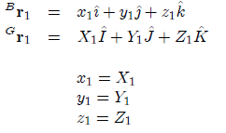
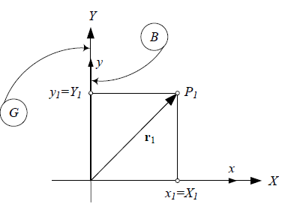
Proof

Slide 16
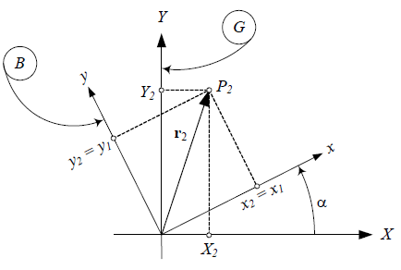




Slide 17
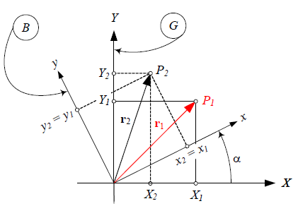





Slide 18


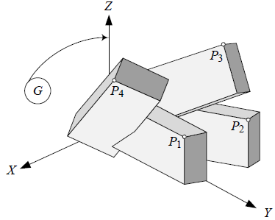

Example 3 Successive rotation about global axes
P1(5, 30, 10) will be rotated by 30 deg about the Z- axis,
followed by 30 deg about the X-axis, and then 90 deg about the Y-axis

Slide 19
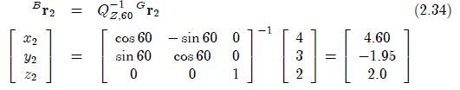
Example 4 Time dependent global rotation
If a point P is moved to , after a 60 deg rotation
About the Z-axis, its position in the local coordinate is

Slide 20
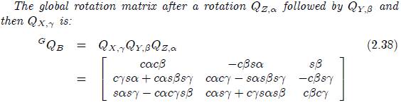
Example 6 Successive global rotation matrix

Slide 21
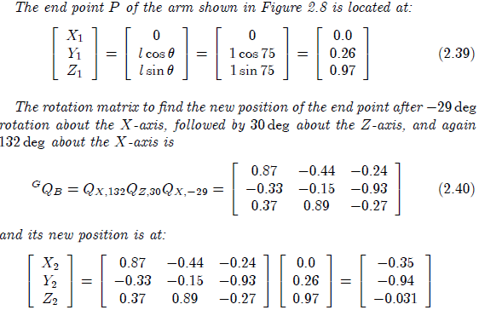
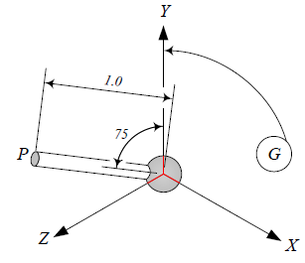
Example 7 Successive global rotations, global position

Slide 22
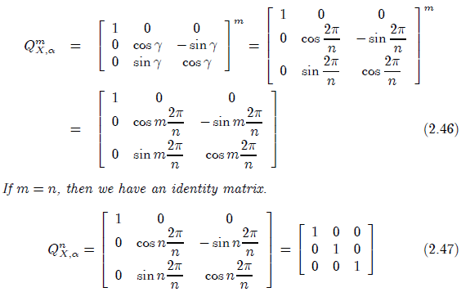
Example 10 Repeated rotation about global axis

Slide 23
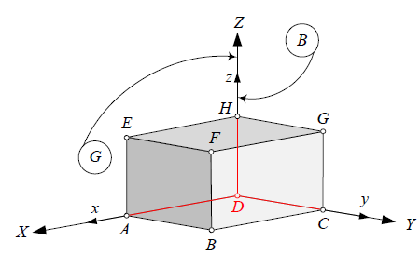
Problem 6. Global rotation of a cube.
Fig. 2.20 illustrates the original position of a cube with a fixed
Point a D and edges of length L = 1.
Coordinates of the corners after rotation of 30deg about Z-axis ?
[x2, y2, z2] = [1, 1, 1]
X2 = cos(30)x2 –sin(30)y2 = 0.866-0.5 =0.366.
Y2 = sin(30)x2 + cos(30)y2 = 0.5 + 0.866 = 1.366
Z2 = z2 = 1
[X2, Y2, Z2] = [0.366, 1.366, 1]

Slide 24
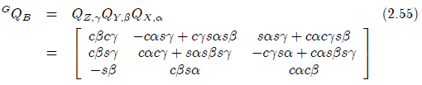
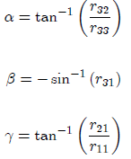
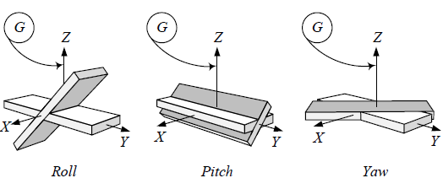
2.3 Global Roll-Pitch-Yaw Angle
The rotation about X-axis of the global coordinate frame is
Called a roll, the rotation about the Y-axis of the global coordinate
frame is called a pitch, and the rotation about the Z-axis of the
global coordinate frame is called a yaw. The global roll-pitch-yaw
rotation matrix is

Slide 25
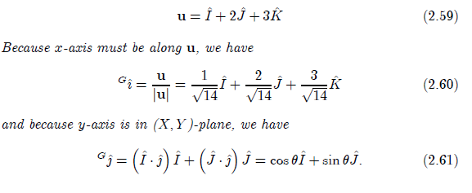
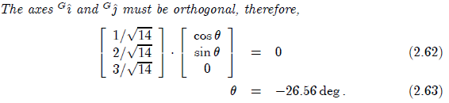
Example 11 Determination of roll-pitch-yaw angles.
Let us determine the required roll-pitch-yaw angles to make
the x-axis of the body coordinate B parallel to u, while y-axis
remains in (X, Y)-plane.

Slide 26

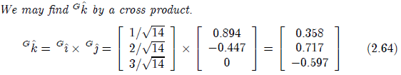
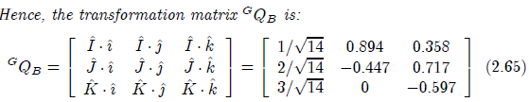

Slide 27
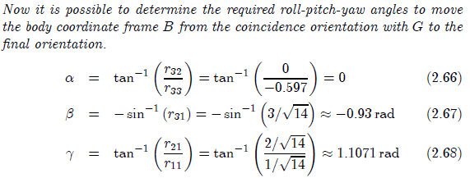

Slide 28
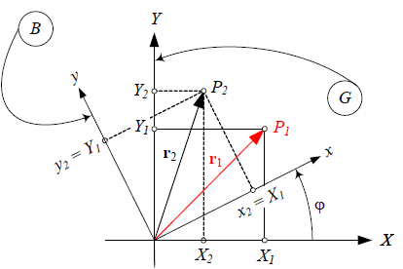

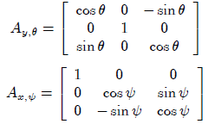
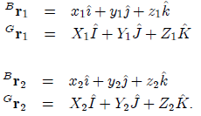
2.4 Rotation About Local Cartesian Axes.
If the body undergoes a rotation a bout the z-axis of its local
Coordinate frame, as can be seen in the top shown in Fig. 20.

Slide 29





Slide 30
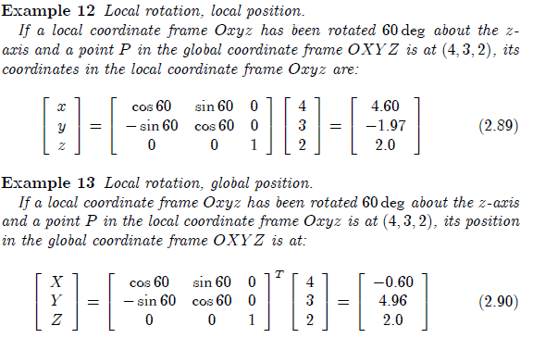

Slide 31

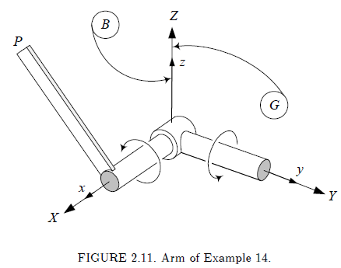
Example 14 Successive local rotation, global position
The first actuator rotates the arm -90 deg about y-axis and then
The second actuator rotates the arm 90deg about x-axis. If the end P
Is at

Slide 32
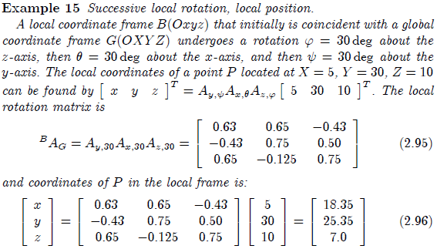
2.5 Successive Rotation About Local Cartesian Axes
The final global position of a point P in a rigid body B with
position vector r, after some rotation A1, A2, A3, …, An about the
local axes can be found by

